Slide 1
Web Application Development Project
Niall Ryan
X12114812
niall.ryan1@student.ncirl.ie

Slide 2
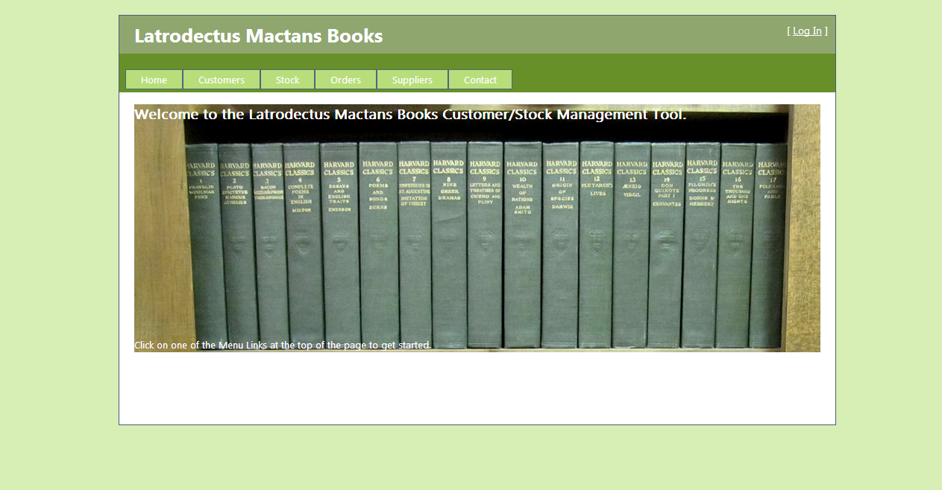
Home Page
Latrodectus Mactans Books Customer/Stock Management Tool

Slide 3
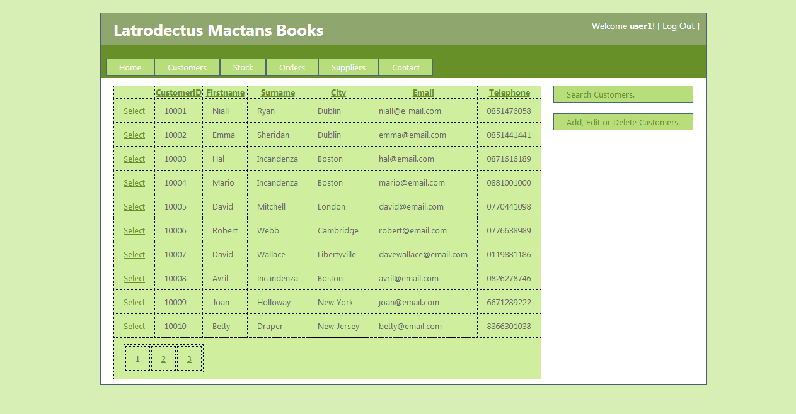
Customers Page
Customers page provides a list of all Customers, links to a page to add, edit or delete
customers and a link to a page to search customers.

Slide 4
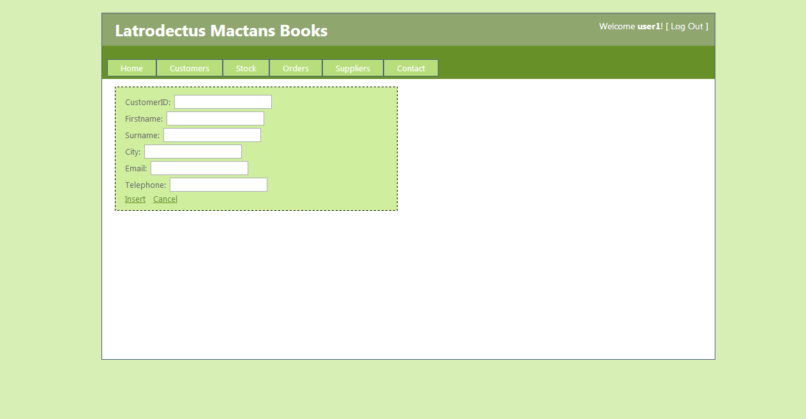
Add Customer
Customers can be added to the database by entering information in the textboxes.

Slide 5
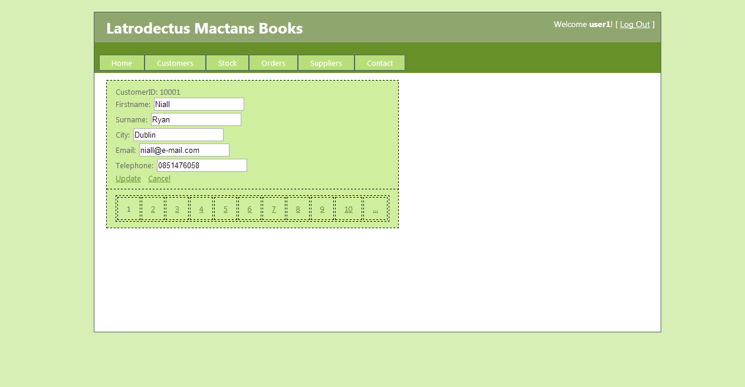
Edit Customer Details
Customers can be edited by changing information in the text boxes.

Slide 6
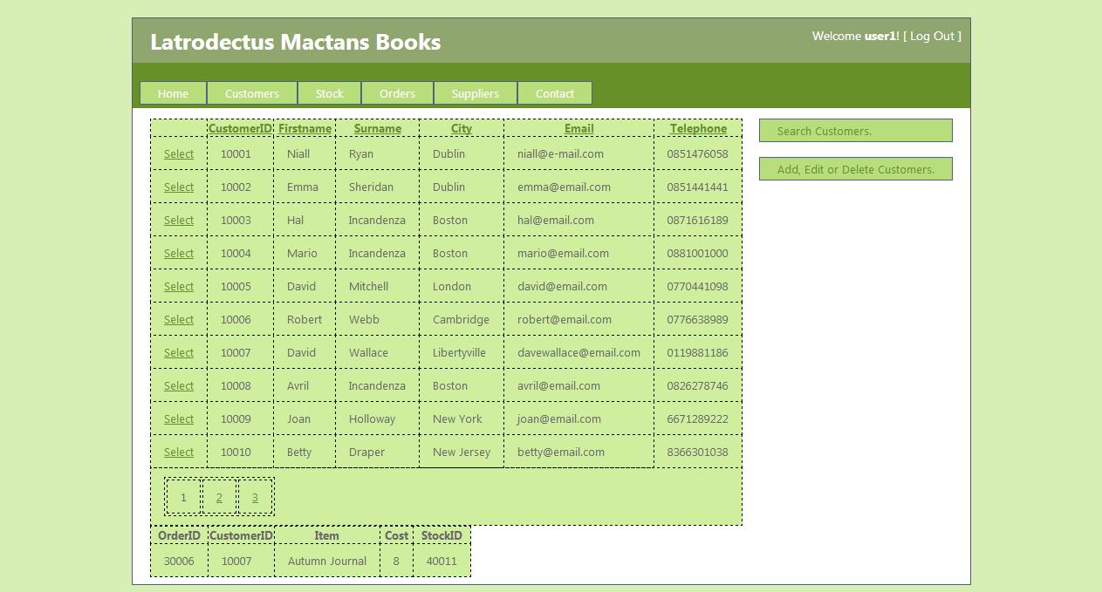
Customer Orders Master Detail Screen
Customers page also features a Master/Detail screen. Clicking on the Customer Row
shows any Orders they have placed at the bottom of the screen.

Slide 7
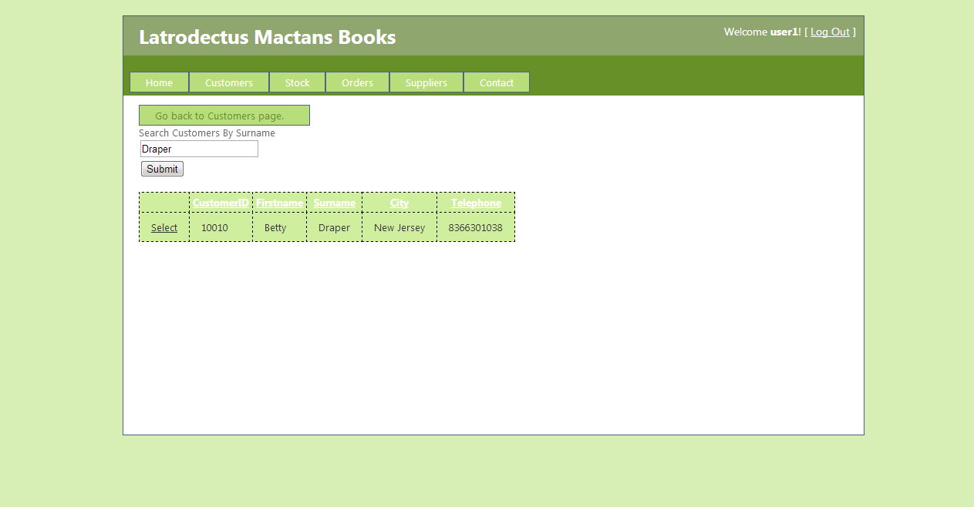
Search Customers
Customer Search features AJAX functionality to allow for easier searching.

Slide 8
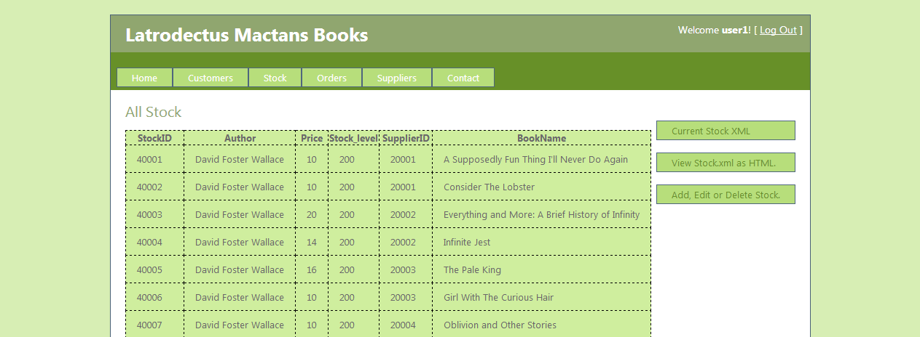
Stock
The Stock Page features a list of all current stock as well as links to an XML file detailing
stock, and links to add, edit or delete stock from the database.

Slide 9
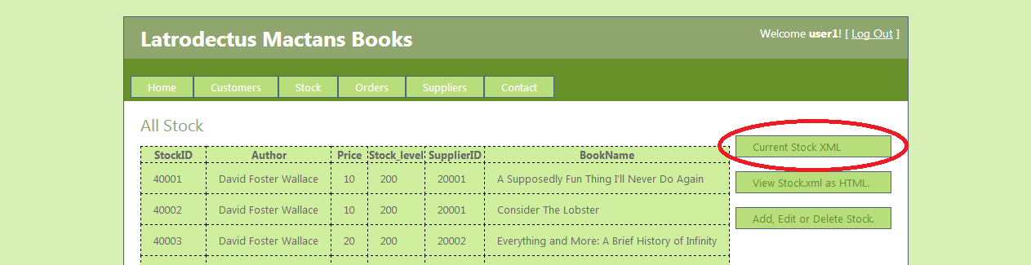
Create Stock XML File

Slide 10
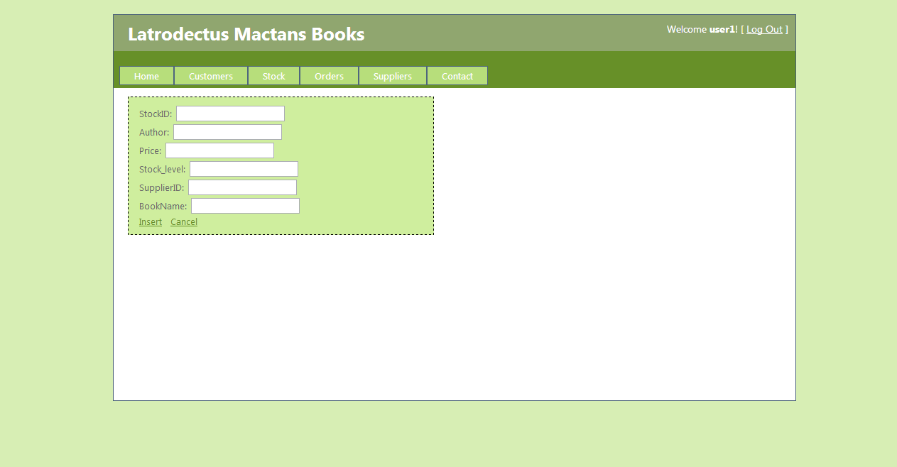
Add Stock
Stock can be added by filling information into the text boxes.

Slide 11
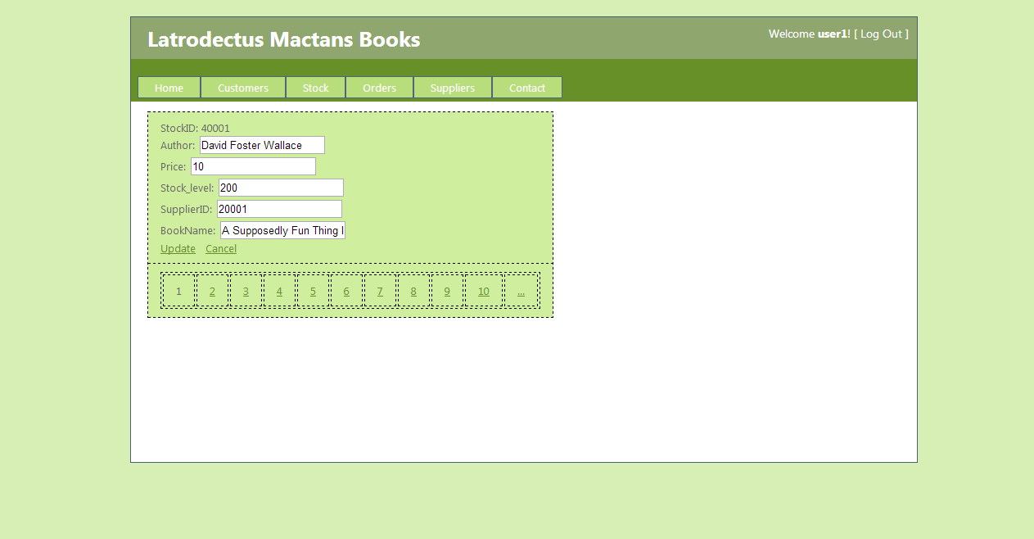
Edit Stock
Stock can be edited by changing information in the text boxes.

Slide 12
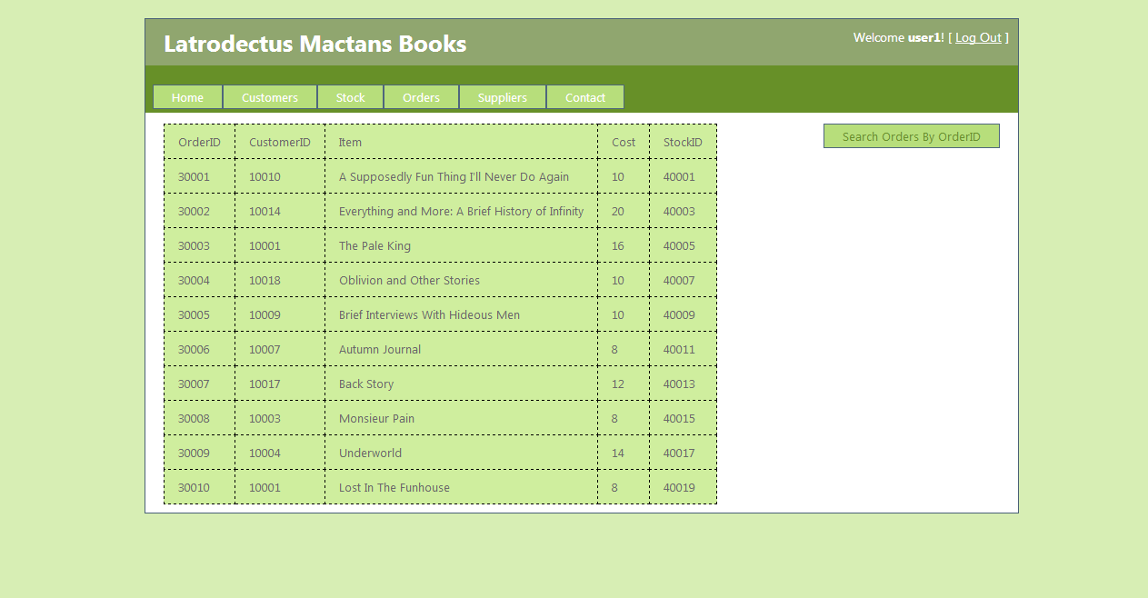
Orders
Orders page features a list of all orders and a link to search all Orders.

Slide 13
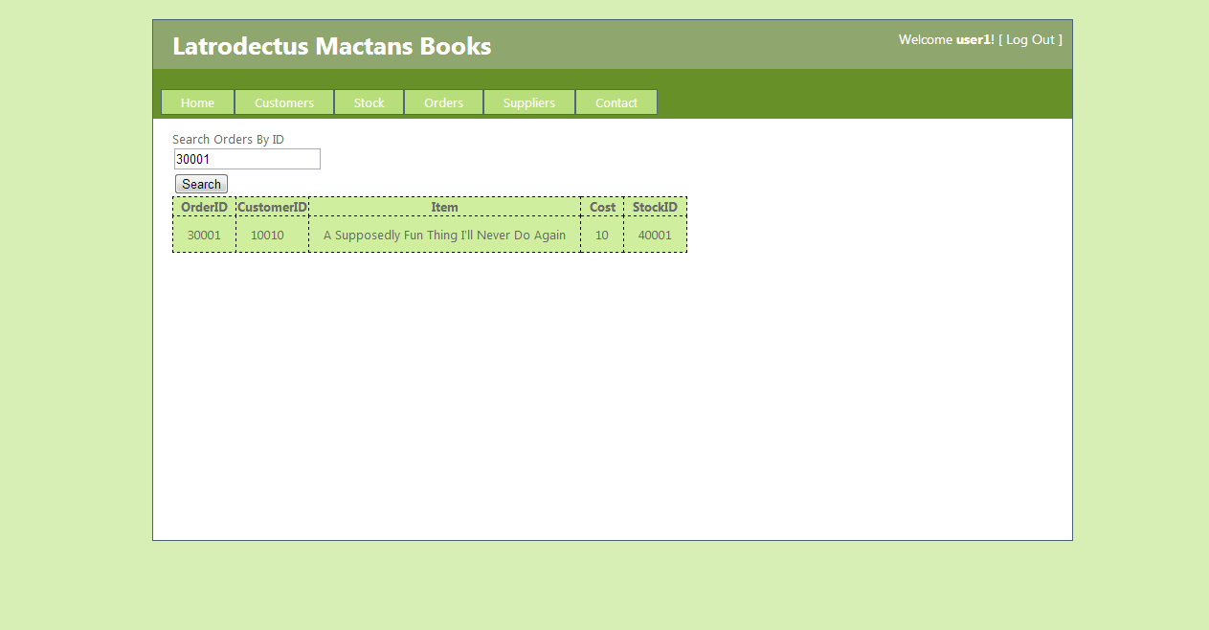
Search Orders
Users can search the Order Table by OrderID

Slide 14
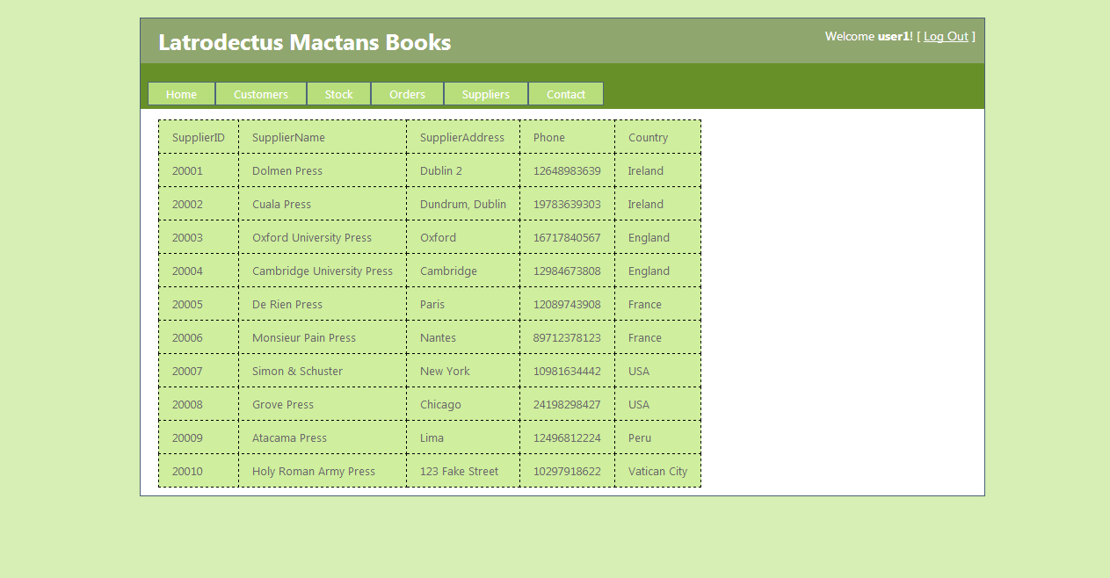
Suppliers
Suppliers page features a list of all Suppliers.

Slide 15
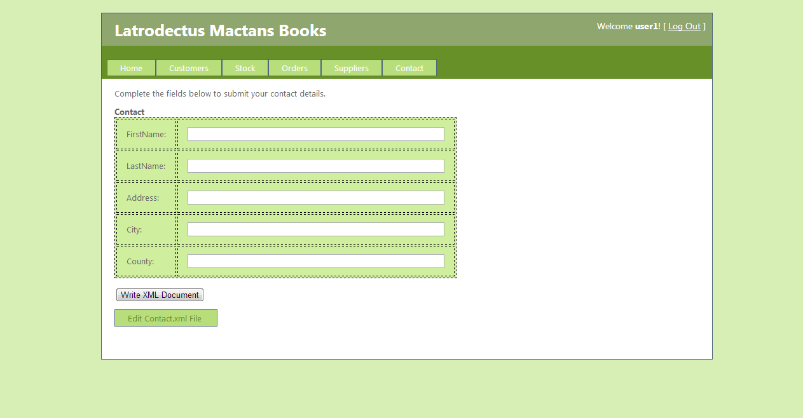
Contact Details
The Contact Details page allows users to create an XML file with their contact details,
and features a link to a page where they can then edit those details.

Slide 16
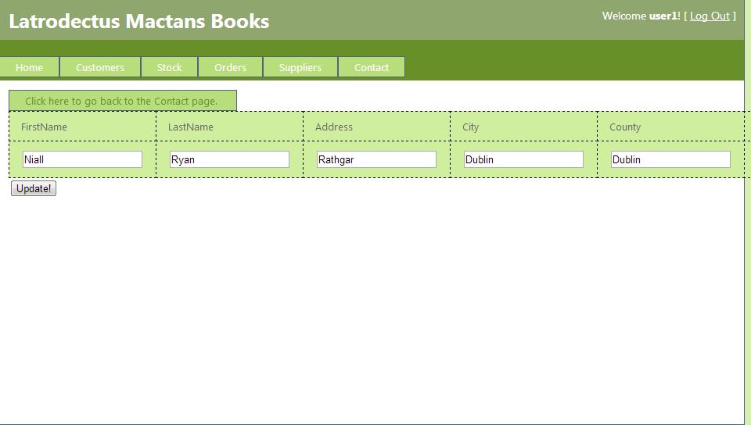
Edit Contact Details
Users can edit the Contact Details XML file by changing the information
in the text boxes.

